Slide 1
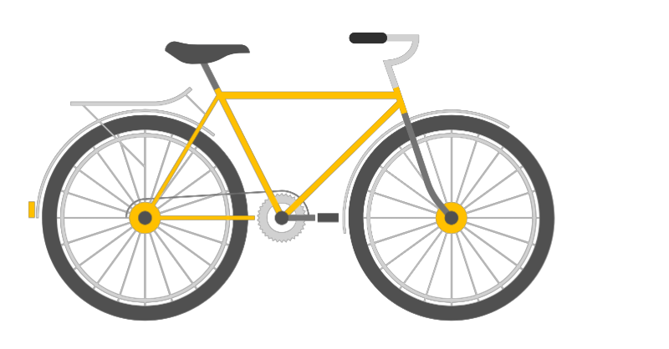
Cyclistic’s
Bike - Share
Presented by: Randall Valverde
Last Updated: June 11th, 2023

Slide 2
Table of contents
01
04
Data Analysis
02
05
Data Overview
Strategies
03
Data Limitations
Goal

Slide 3

Goal
To understand the differences in how annual members and casual riders use Cyclistic’s bikes and provide insights into their usage patterns, preferences, and behaviors.

Slide 4
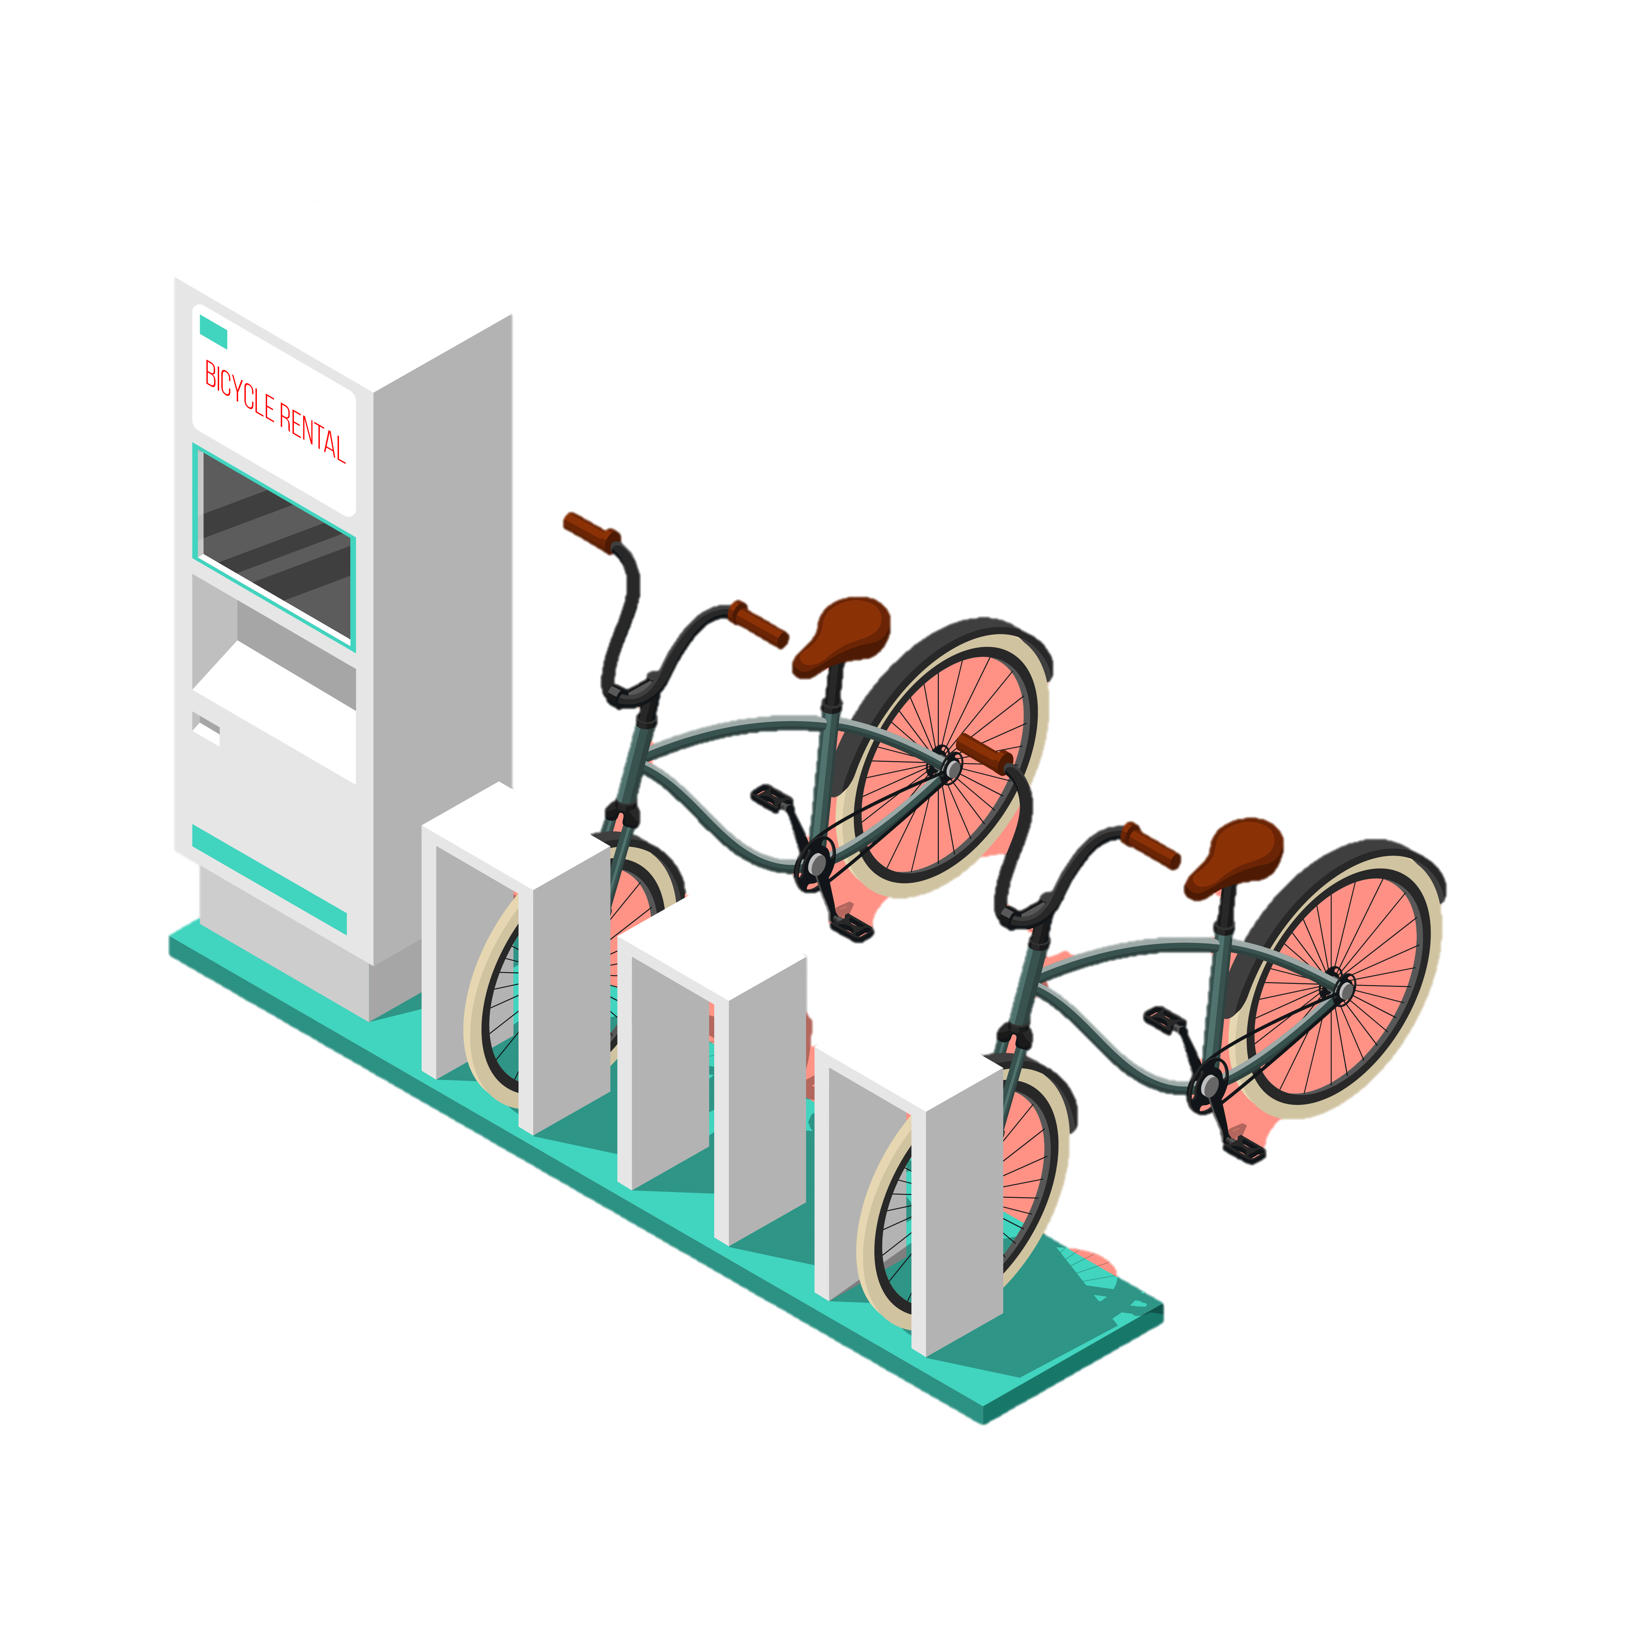
Data Overview
Cyclistic’s bike-share program has over 5,800 bicycles and 600 docking stations installed around Chicago.
Dataset consists of 12 CSV files each per month with 13 columns and 5,859,061 rows.
Data is stored in Amazon Web Server and is owned by Motivate International Inc under this license.

Slide 5
Data Limitations
Lack of demographic data like age, gender, careers/lifestyle.
Absence of membership prices.
27% of all electric bikes are missing the start station name.

Slide 6
Data Analysis

Slide 7
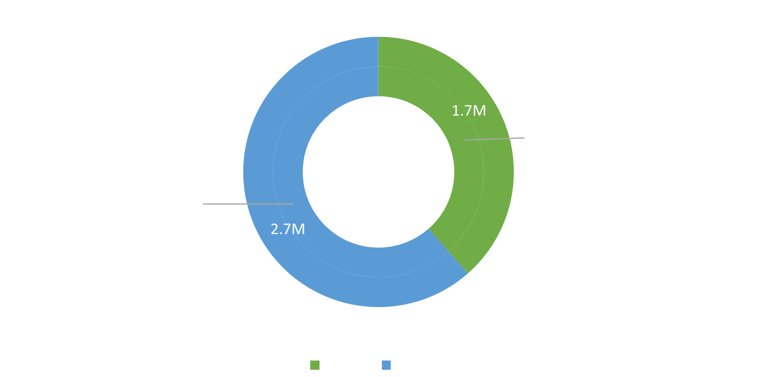
Members vs Casuals

Slide 8
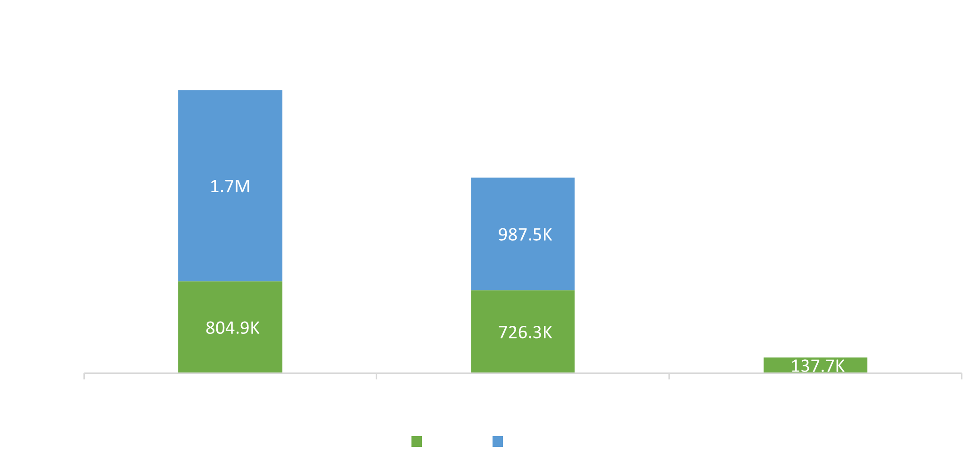
Bike Preference
19% of Casuals prefer Classic Bikes
17% of Casuals prefer Electric Bikes
Notes:
Classic Bikes are more popular among users, indicating a preference for this bike type over other options. It would be interesting to explore the reasons behind this preference and assess if any improvements or adjustments can be made to cater to user preferences.

Slide 9
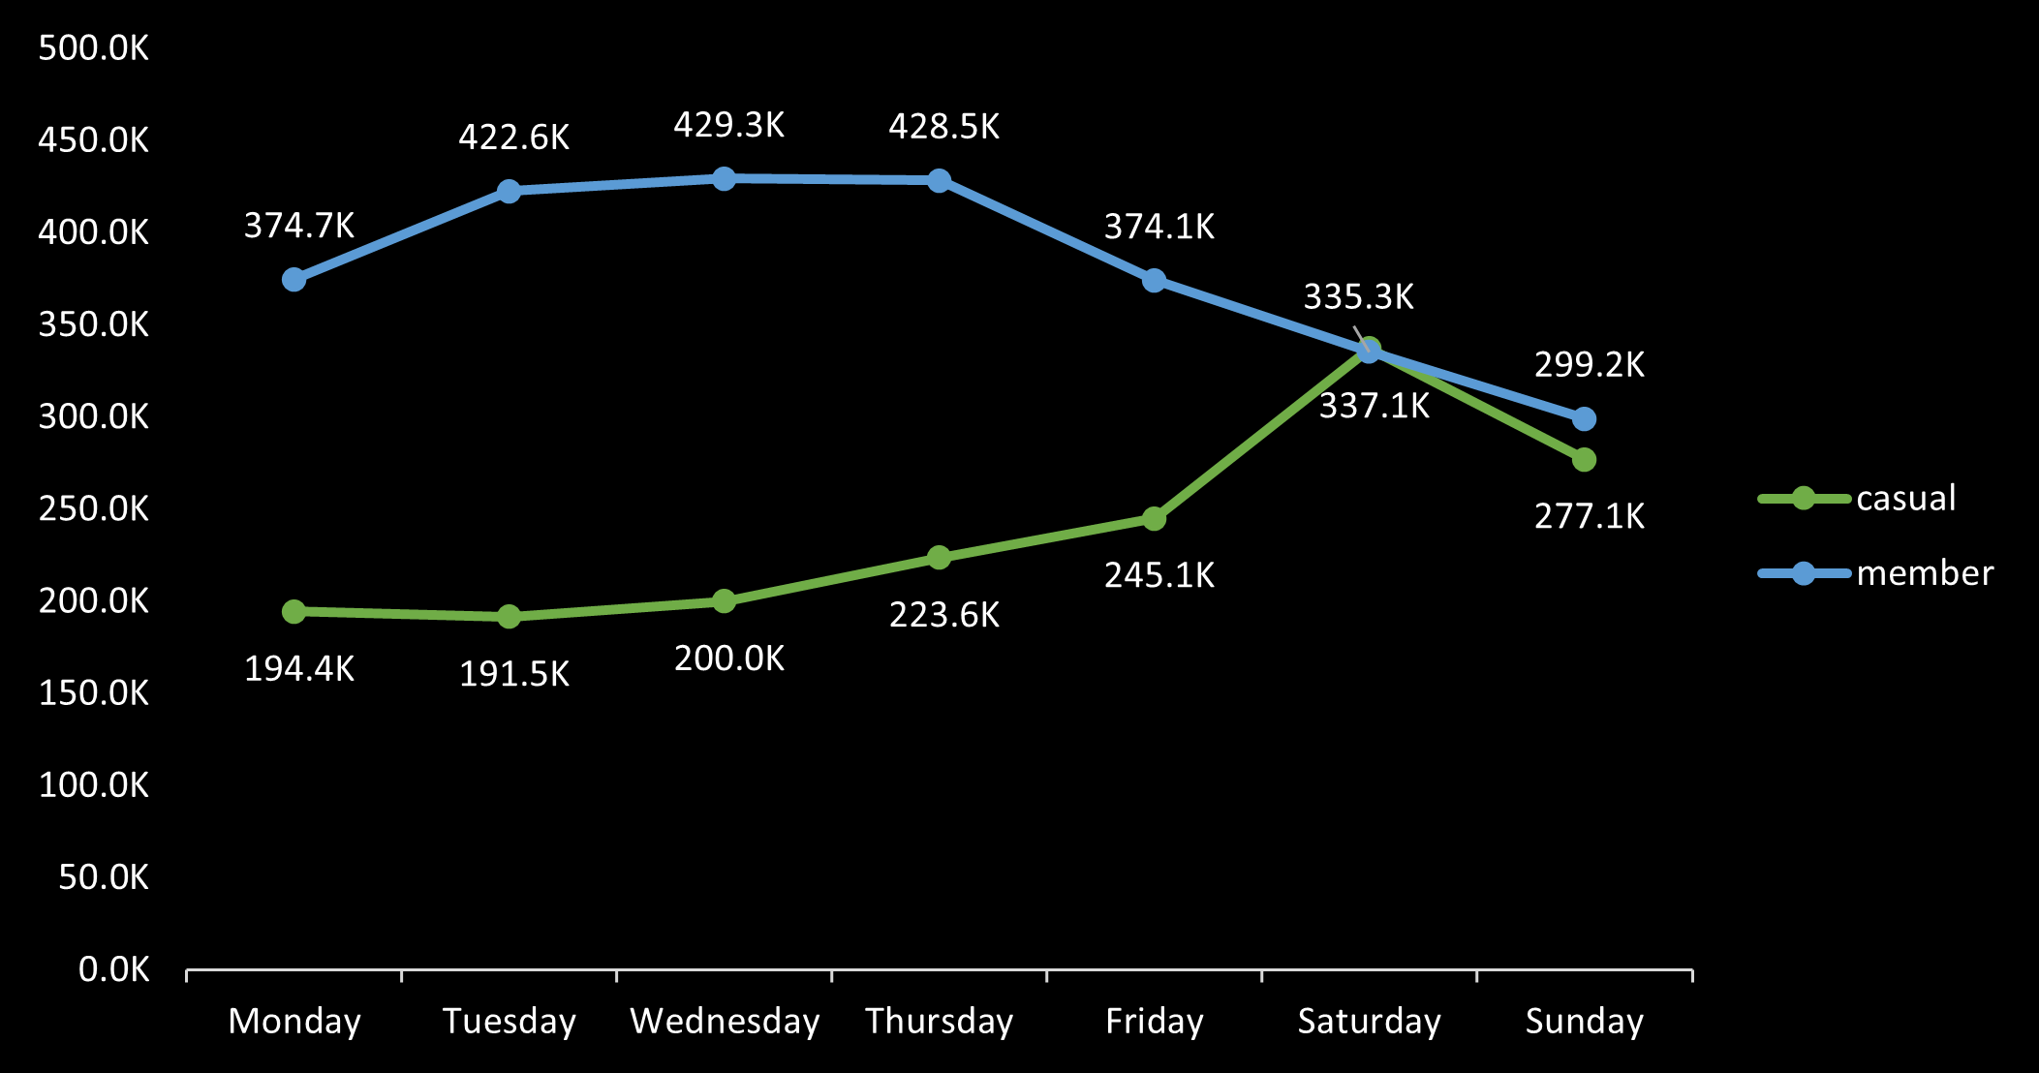
Weekly Usage Members vs Casuals
Weekends are the busiest days for Casuals
Week days are the busiest among Members
Notes:
Weekends are the busiest days for casual riders, suggesting that individuals use the bike share service for recreational purposes or weekend activities.

Slide 10
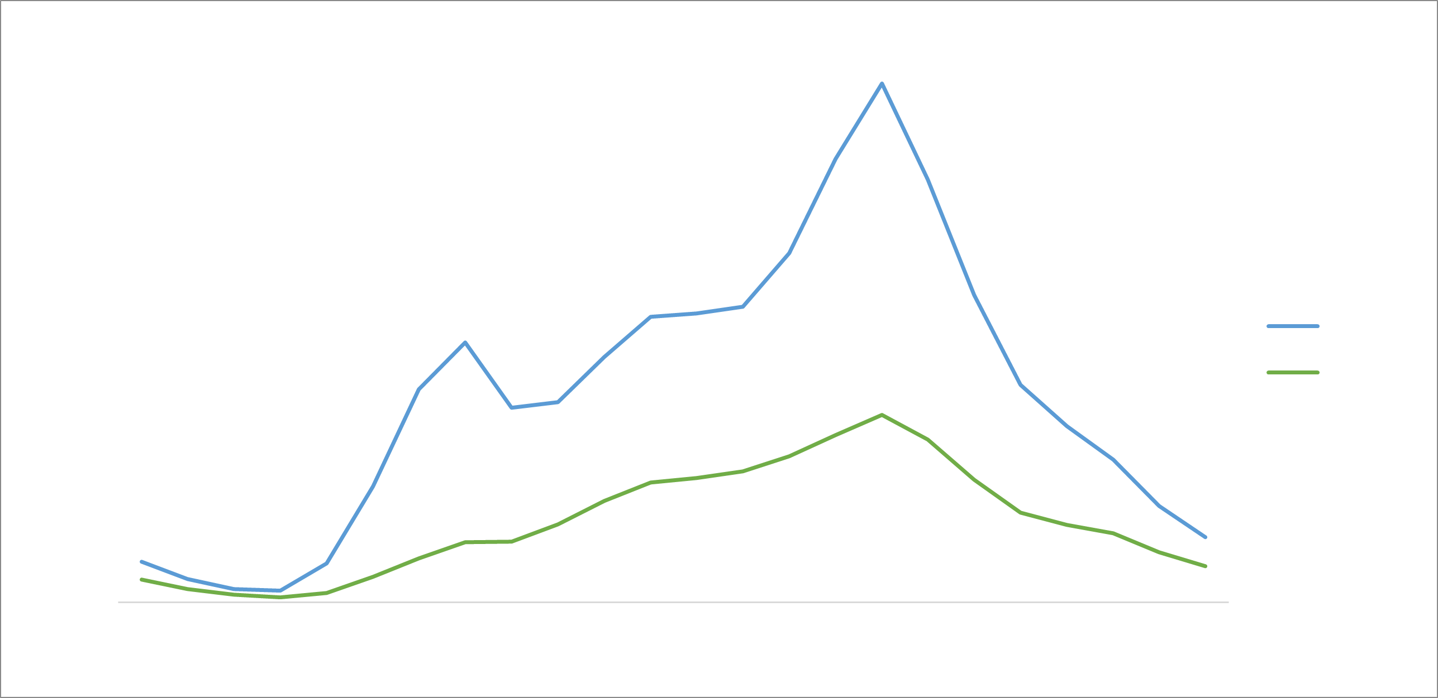
Hourly Usage Members vs Casuals
Peak hour usage for Casuals and Members aligns with typical commute hours
Notes:
Members tend to use the bikes more during the weekdays, implying that they utilize the bikes for commuting to work or other regular activities. This observation is further supported by the hourly analysis, which shows usage peaks at 7-8 AM and 4-5 PM, aligning with typical commuting hours.

Slide 11
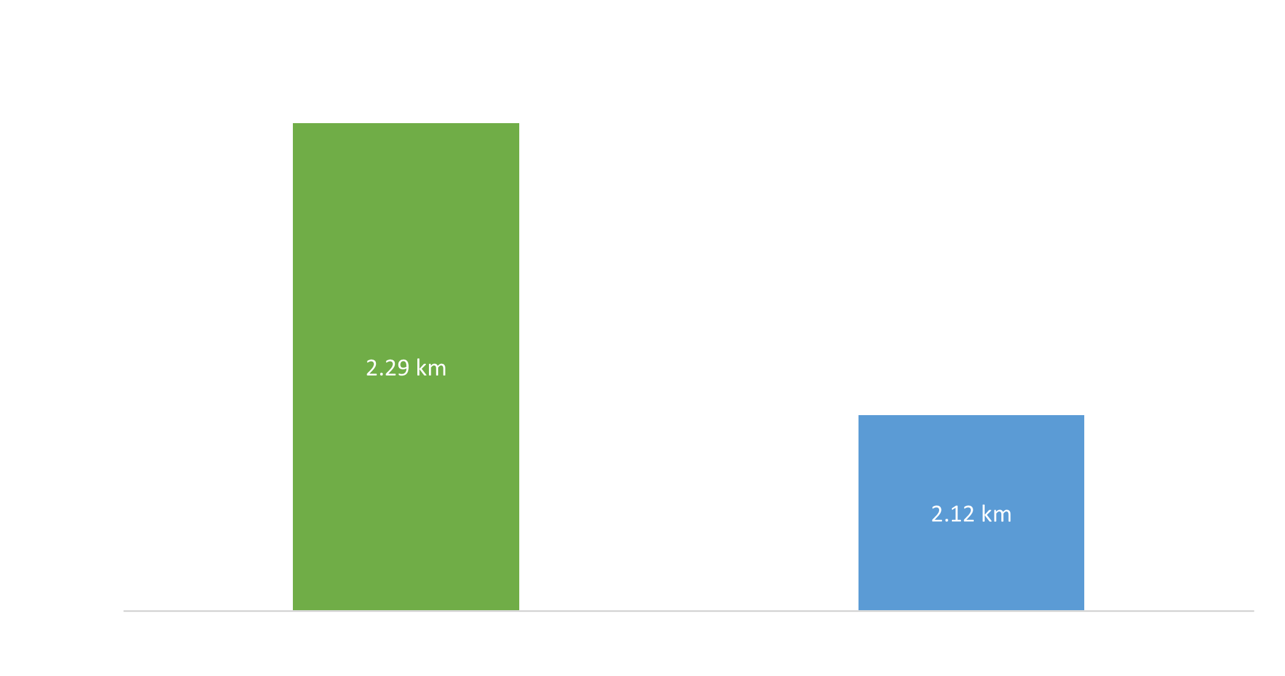
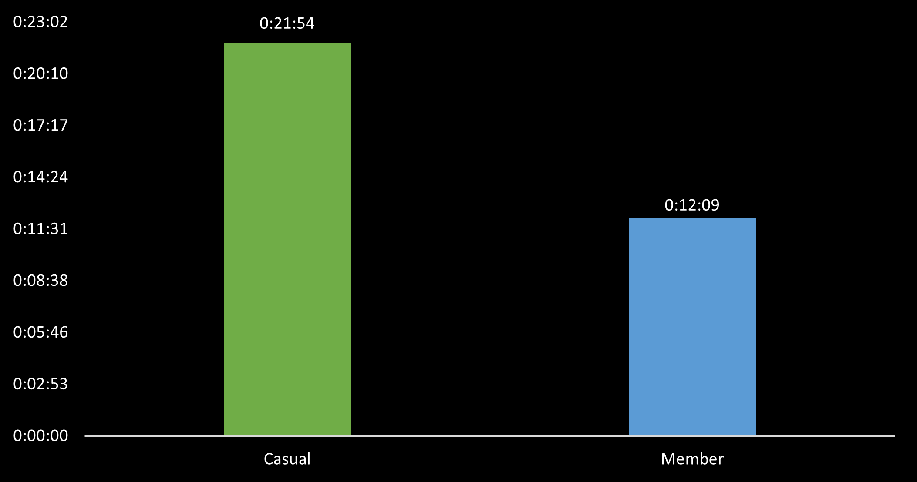

Ride Duration and Distance
Casuals cover more distances and take longer rides than members
Notes:
Casual rides typically take longer than rides by members, indicating that casual users may engage in more leisurely or exploratory trips. Understanding the factors contributing to longer casual rides can help tailor marketing efforts or develop targeted services to cater to their preferences.
Casual riders also cover more distances compared to members, suggesting a different usage pattern or purpose for bike usage. Exploring the reasons behind this difference can provide insights into the needs and motivations of different user segments.

Slide 12
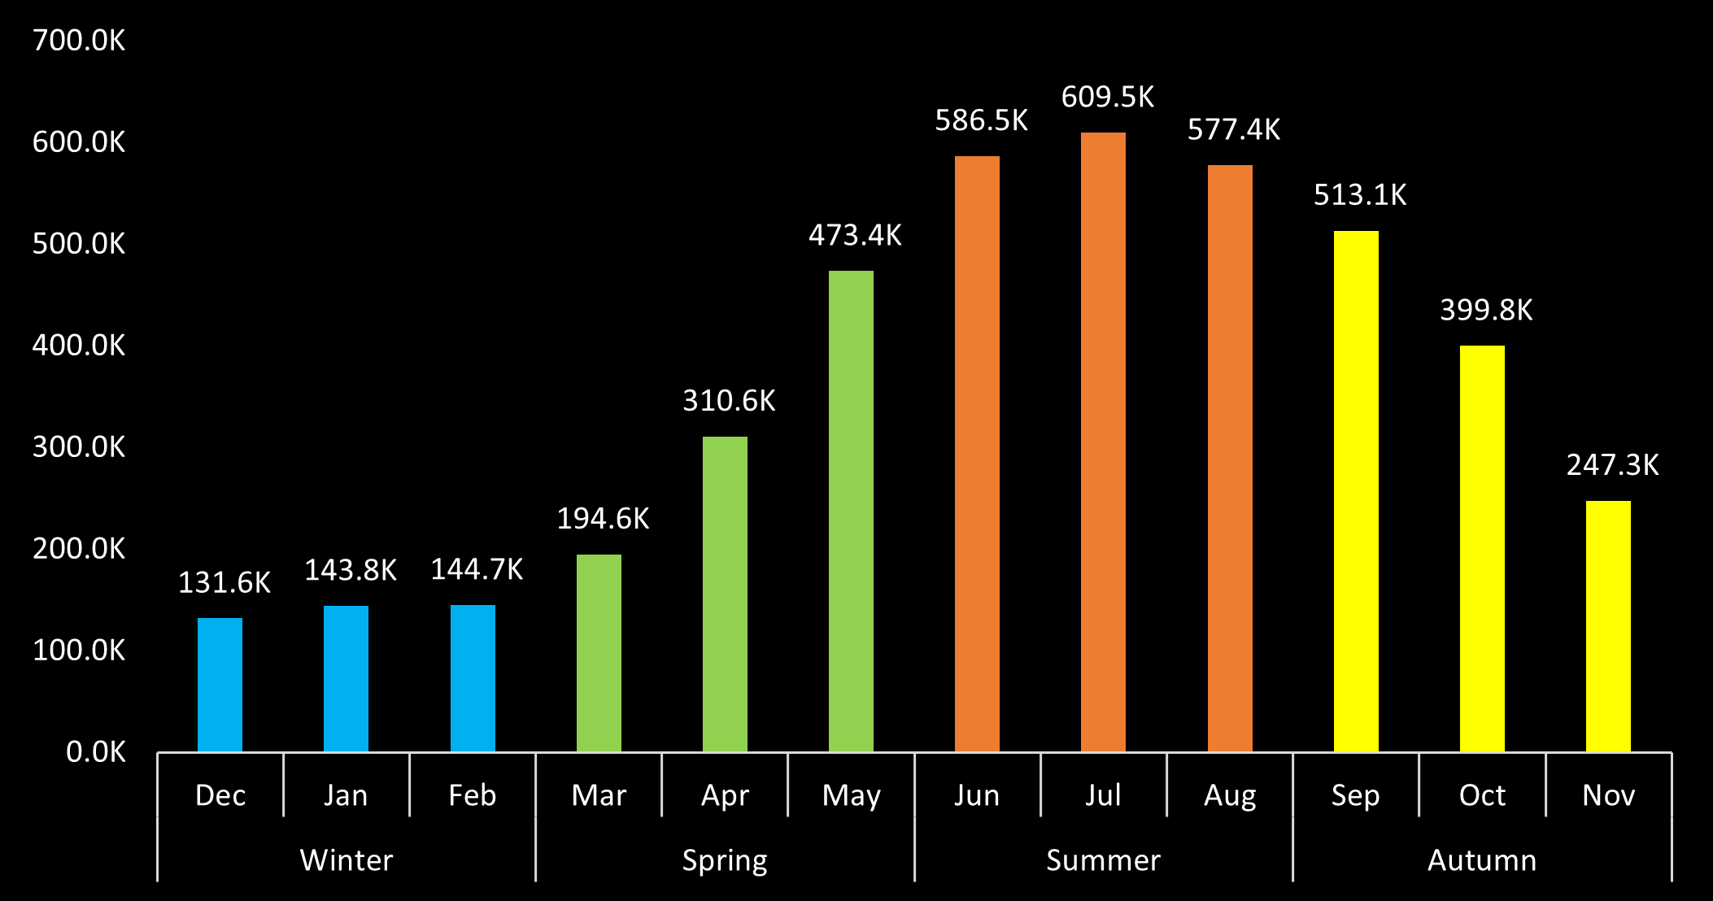
Bike Preference
Summer and Autumn emerge as the busiest seasons for bike usage.
Notes:
Summer and Autumn emerge as the busiest seasons for bike usage. This trend could be attributed to favorable weather conditions during these seasons, making cycling a more appealing mode of transportation or leisure activity. It would be valuable to analyze the impact of weather conditions on bike usage and explore strategies to maintain user engagement during less favorable seasons.

Slide 13
Key Findings Summary
61% of all rides are performed by Members.
Classic Bikes are more popular among users.
Weekends are the busiest days for casual riders.
Members tend to use the bikes more during the weekdays, implying that they utilize the bikes for commuting to work or other regular activities.
Peak hours are 7-8 AM and 4-5 PM, aligning with typical commuting hours.
Casual rides typically take longer than rides by members.

Slide 14
Strategies to Engage Casual Users

Slide 15


1
Membership Savings: Emphasize the convenience and cost savings of being a member, especially for frequent riders. Showcase how membership allows for easy access to bikes during peak hours and offers discounted rates compared to casual usage. This addresses the finding that members tend to use bikes more during the week, potentially for commuting purposes.
2
Offer Exclusive Weekend Promotions: Create special weekend promotions or packages specifically targeted towards casual riders. Highlight the benefits of becoming a member for weekend activities, such as extended ride durations or discounts for popular leisure destinations. This aligns with the finding that weekends are the busiest days for casual riders.

Slide 16


3
Develop Partnerships with Local Businesses: Collaborate with local businesses, particularly those that attract casual riders, to offer joint promotions or discounts. For example, partnering with outdoor gear stores or tourist attractions can provide added value to casual riders who may engage in more leisurely or exploratory trips. This addresses the finding that casual riders tend to cover more distances.
4
Loyalty and Referral Programs: Implement loyalty programs to reward regular users during the lower months. Offer incentives such as free ride credits, exclusive perks, or priority bike access. Additionally, encourage current users to refer their friends, family, or colleagues to join the bike share service by providing referral bonuses or discounts.

Slide 17
Thanks!

